Slide 1







Stack Overflow Developer Survey 2019
Asif Dawood
16 July 2024

Slide 2



OUTLINE
Executive Summary
Introduction
Methodology
Results
Visualization – Charts
Dashboard
Discussion
Findings & Implications
Conclusion
Appendix

Slide 3

EXECUTIVE SUMMARY
Trends in Programming languages and Databases
Gender Gap
Demographics Survey

Slide 4

INTRODUCTION
Identifying the Programing languages and Databases expected to be popular and in demand for the future
Can fill in the skill gaps
Identifying top Programming languages in demand at present
Identifying top Databases and Frameworks in demand
Gender gap in Technology

Slide 5

METHODOLOGY
Collect data using the following technologies
Web Scrapping
Requests Library
API’s
From GitHub Postings, Stack overflow survery
Data Cleaning and wrangling
Exploratory Data Analysis
Data Visualization
Reports

Slide 6
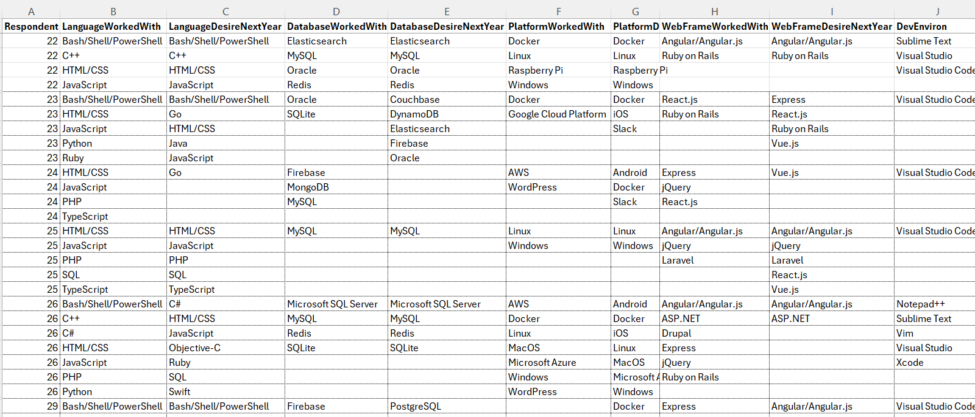
RESULTS
Snapshot of the Result Database

Slide 7
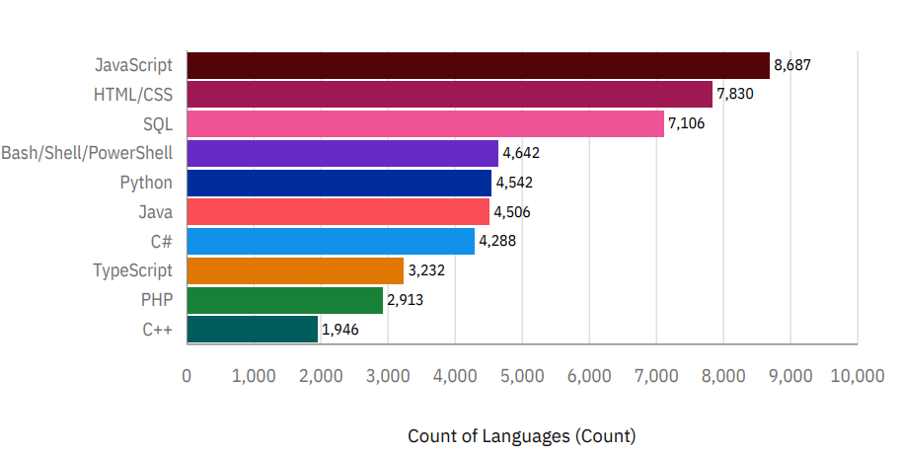
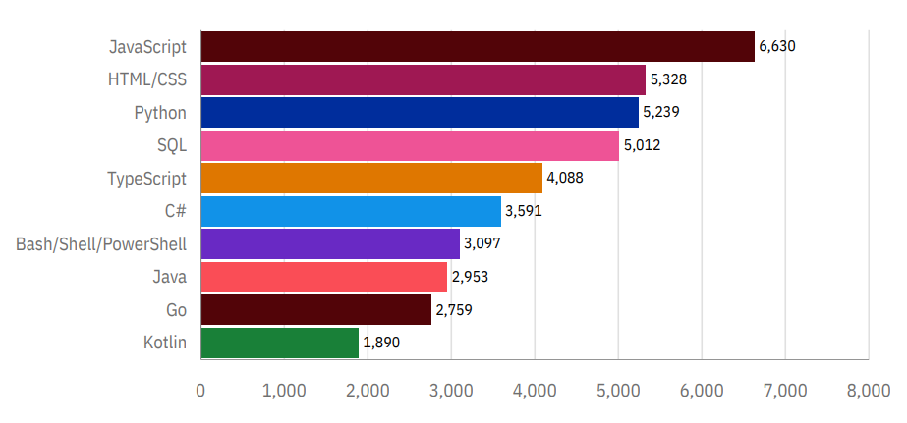
PROGRAMMING LANGUAGE TRENDS
Current Year
Next Year

Slide 8
PROGRAMMING LANGUAGE TRENDS - FINDINGS & IMPLICATIONS
Findings
Javascript and HTML are top choices
Followed by SQL for data data driven decisions
Python is also rising due to its versatility
Implications
Javascript and HTML still remains at the top implying Web development will be the way forward
Python will also be in demand to its role in AI and ML
Since data is everywhere , SQL retains is hold

Slide 9
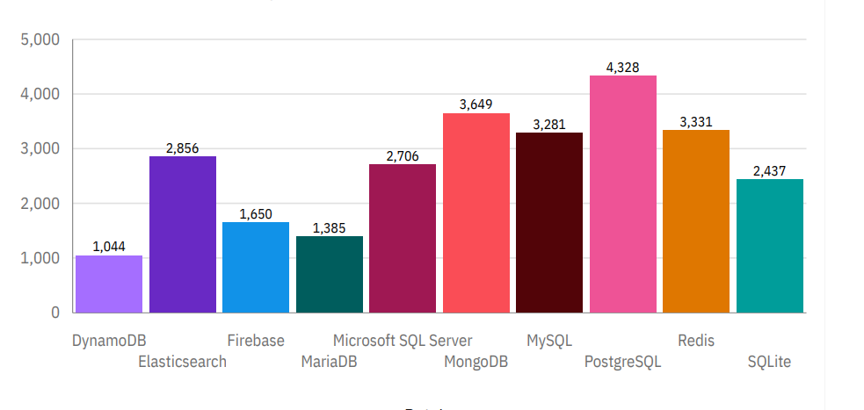
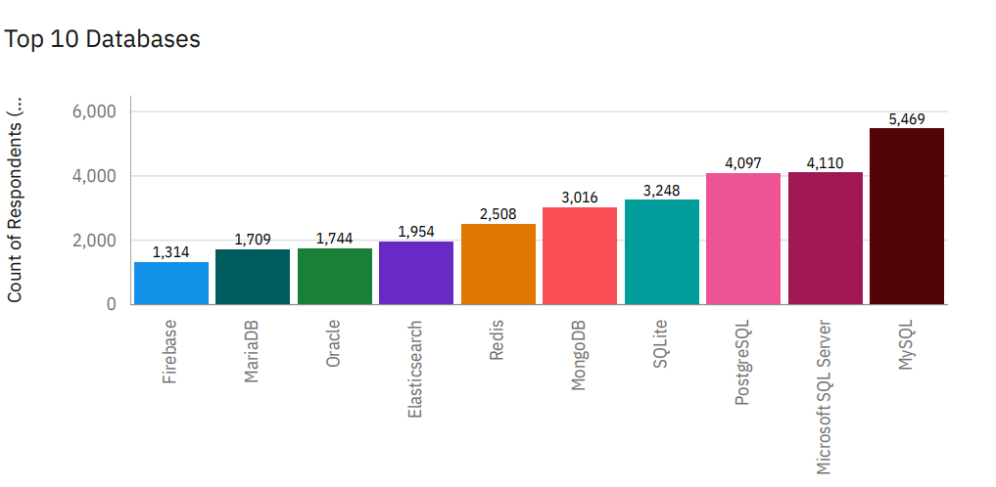
DATABASE TRENDS
Current Year
Next Year

Slide 10
DATABASE TRENDS - FINDINGS & IMPLICATIONS
Findings
MySQL is reigning at the top
Followed by Miscrosoft SQL
And Postgress SQL
Implications
Postgress becoming the favorite
Since non structed, data is being analyzed Mongo DB has risen in popularity
Redis is also rising due to its capability is analyzing NoSQL DBs

Slide 11

DASHBOARD
Find the dashboard for this study here:
https://github.com/asifdawood/IBM-Data-Analytics-CapStone-Project/blob/7244819e0baf39ff70ad2d40a5b5987425cca21b/Task5/IBM%20Data%20Analytics%20Cognos%20Project.pdf

Slide 12
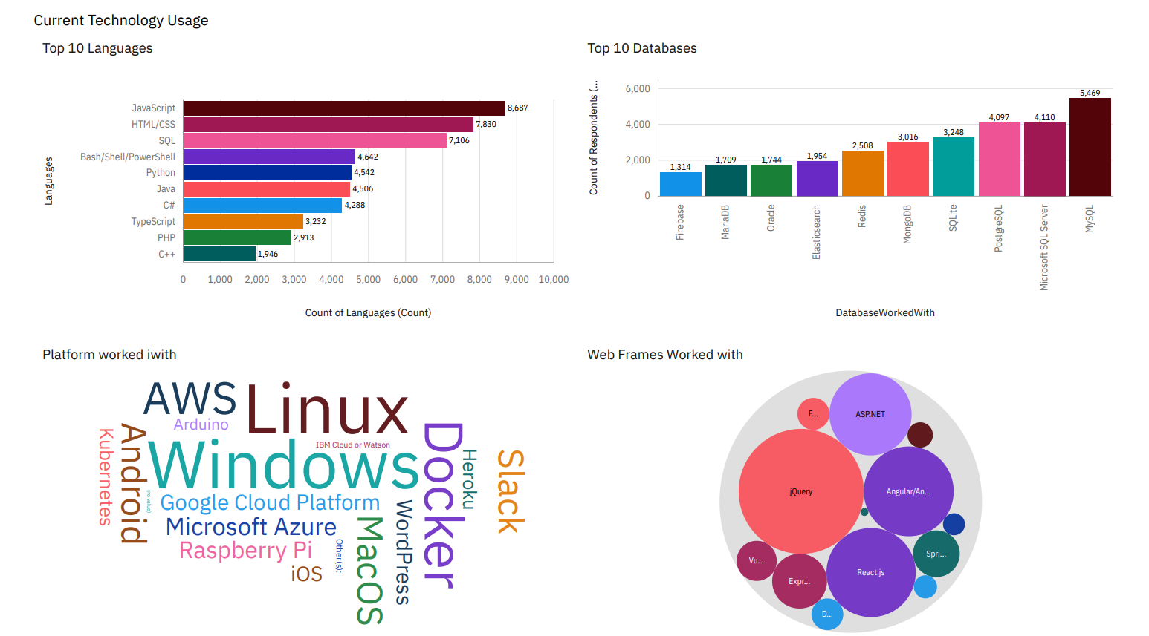
DASHBOARD TAB 1

Slide 13
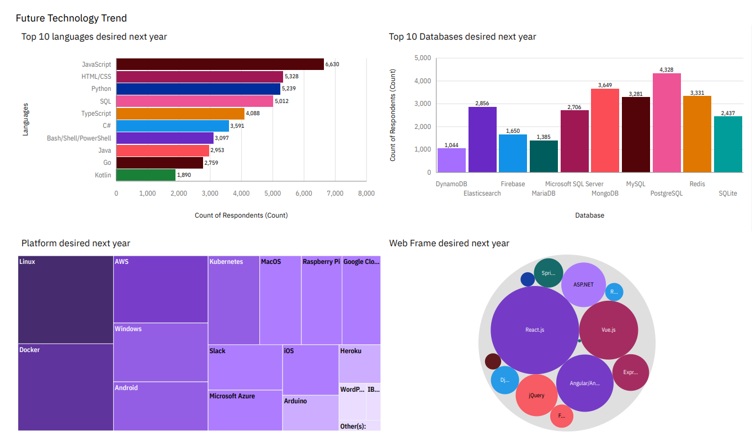
DASHBOARD TAB 2

Slide 14
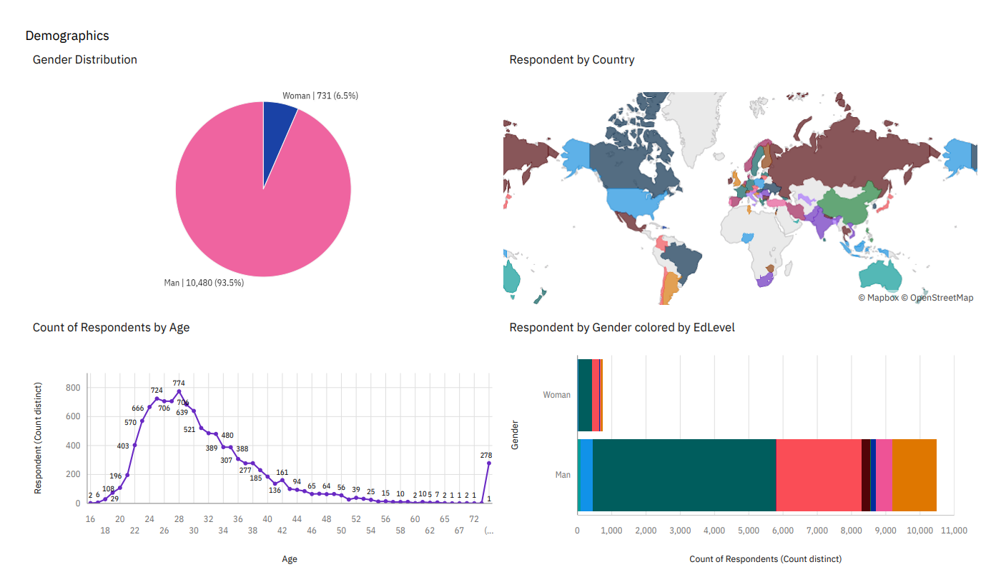
DASHBOARD TAB 3

Slide 15
DISCUSSION
Training and filling of Skill-gaps
Trend in Technology
Gender disparity in the field of technology
Technology gaps between developed and developing regions

Slide 16
OVERALL FINDINGS & IMPLICATIONS
Findings
Concentration of technology in select countries
Gender gap only around 6% women in the field of technology
Rise of No SQL databases
Implications
The Rise of NoSQL databases like MogoDB,Redis etc implies the data in any form is important and needs to be analysed for better data driven decisions
The gender gap and gap in technologies between Regions to be bridged

Slide 17

CONCLUSION
A good overview of the rising technology trends
Identified the Gender gaps in technology
Also Noticed that technology gap was prevalent between regions
NoSQL is gaining ground indicates that non structured data is now increasingly utilized for analysing data

Slide 18
JOB POSTINGS

Slide 19
POPULAR LANGUAGES

